Slide 1
Section 6.9
Building Exponential, Logarithmic, and Logistic Models from Data
Copyright © 2012 Pearson Education, Inc. Publishing as Prentice Hall.

Slide 2
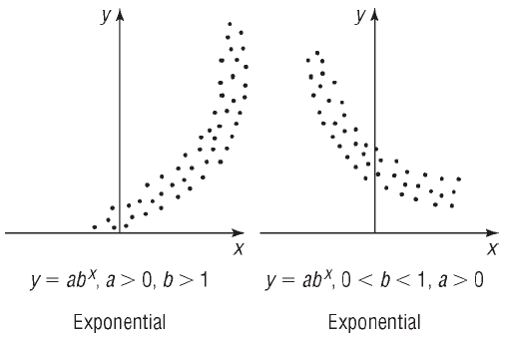
Copyright © 2012 Pearson Education, Inc. Publishing as Prentice Hall.

Slide 3
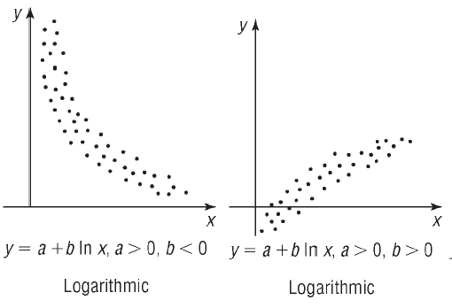
Copyright © 2012 Pearson Education, Inc. Publishing as Prentice Hall.

Slide 4
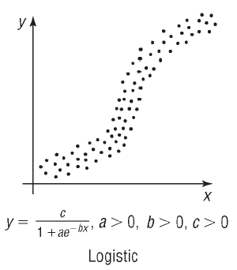
Copyright © 2012 Pearson Education, Inc. Publishing as Prentice Hall.

Slide 5
Copyright © 2012 Pearson Education, Inc. Publishing as Prentice Hall.

Slide 6

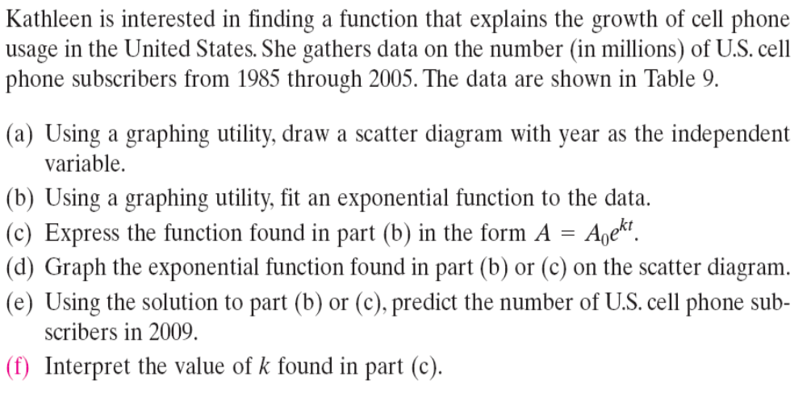
Table on next slide
Copyright © 2012 Pearson Education, Inc. Publishing as Prentice Hall.

Slide 7
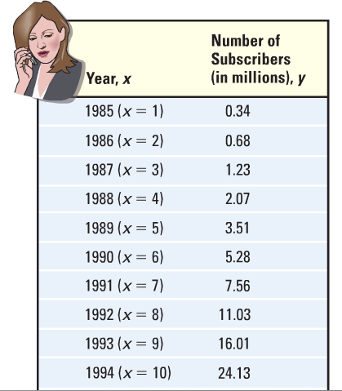
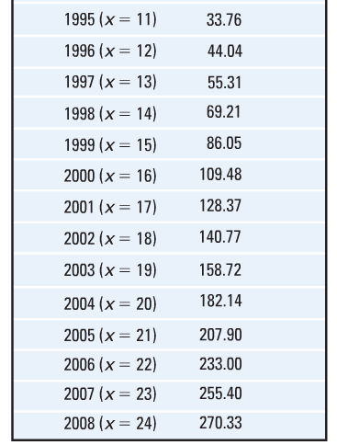
Table 9
(next slide)
Copyright © 2012 Pearson Education, Inc. Publishing as Prentice Hall.

Slide 8
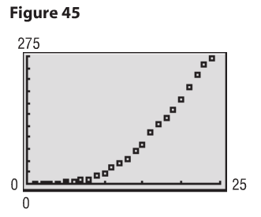
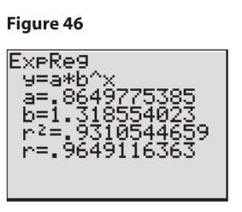
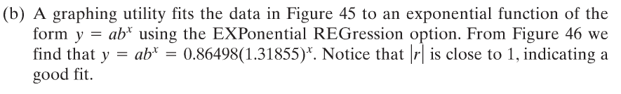
Copyright © 2012 Pearson Education, Inc. Publishing as Prentice Hall.

Slide 9
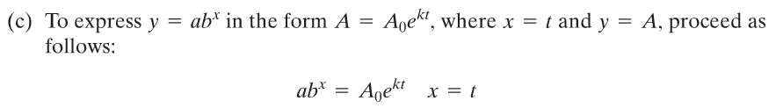
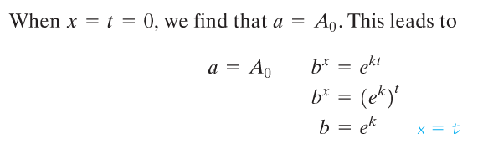


Copyright © 2012 Pearson Education, Inc. Publishing as Prentice Hall.

Slide 10
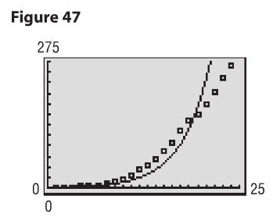
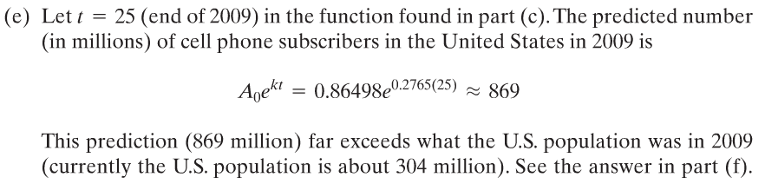
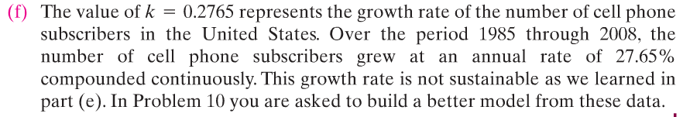
Copyright © 2012 Pearson Education, Inc. Publishing as Prentice Hall.

Slide 11


Copyright © 2012 Pearson Education, Inc. Publishing as Prentice Hall.

Slide 12
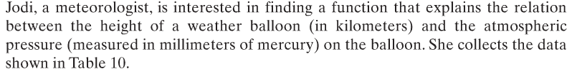
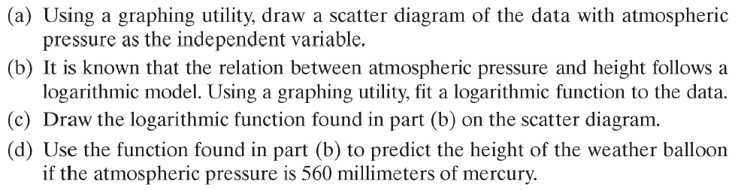
Table on next slide
Copyright © 2012 Pearson Education, Inc. Publishing as Prentice Hall.

Slide 13
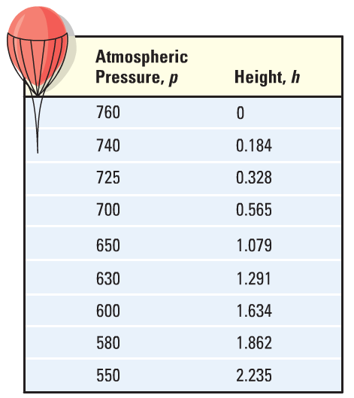
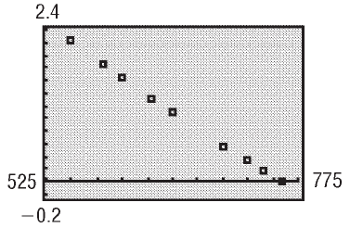
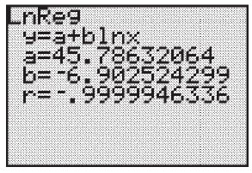
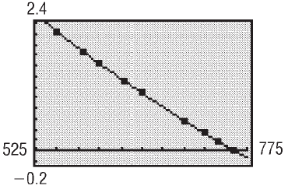


Table 10
Copyright © 2012 Pearson Education, Inc. Publishing as Prentice Hall.

Slide 14
Copyright © 2012 Pearson Education, Inc. Publishing as Prentice Hall.

Slide 15
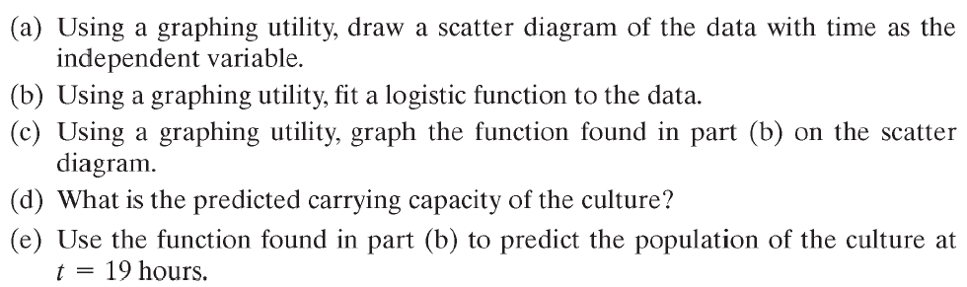
Table on next slide
Copyright © 2012 Pearson Education, Inc. Publishing as Prentice Hall.

Slide 16
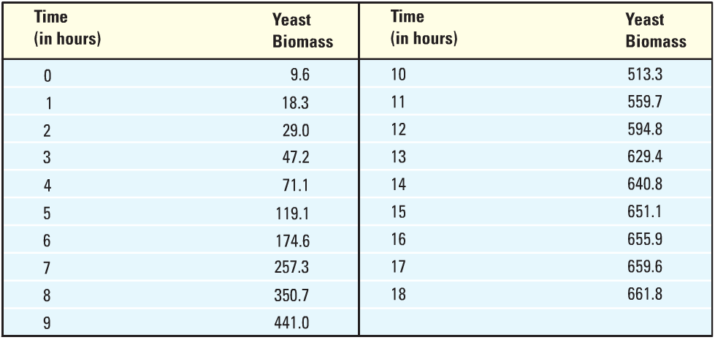
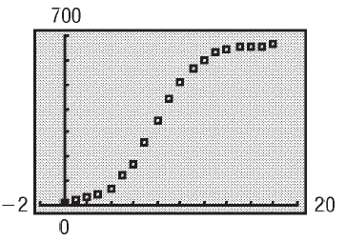
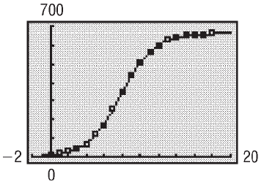
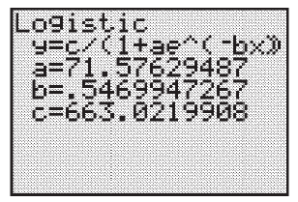
Table 11
Copyright © 2012 Pearson Education, Inc. Publishing as Prentice Hall.

Slide 17

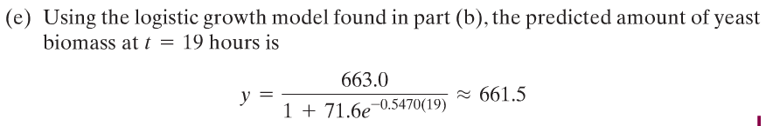
Copyright © 2012 Pearson Education, Inc. Publishing as Prentice Hall.

